Slide 1

Autonomous Vehicle Navigation System Using Deep Learning and Computer Vision with Real-time Object Detection
SVR ENGINEERING COLLEGE (AUTONOMOUS)
PRESENTED BY:
S. Reshma (21AM1A3198)
D. Rajesh (21AM1A3193)
M. Prabhas (21AM1A3186)
K. Revanth (21AM1A3199)
GUIDED BY:
M. Rama Chandrudu M.Tech
(Assistant Professor)

Slide 2
Contents
Abstract
Introduction
Existing System and it’s disadvantages
Proposal System and it’s advantages
System Requirements
System architecture
UML diagram
Modules Overview and Methodology Used
Description of Each Module
Algorithms used in your model
Screen shots
Results
Conclusion & future scope

Slide 3
Abstract
In this project using python and OpenCV and YOLOv8 module we are detecting objects, speed from videos and webcam.
This application consists of Three modules such as ‘Deep Learning-based Object Detection.’ and ‘Computer Vision ’ and ‘YOLOv8 (You Only Look Once, version 8’.
The system ensures enhanced safety, adaptability to diverse conditions, and scalability for urban and highway environments.

Slide 4
Introduction
>Many problems in computer vision were saturating on their accuracy before a decade.
>However, with the rise of deep learning techniques, the accuracy of these problems drastically improved.
>One of the major problem was that of image classification, which is defined as predicting the class of the image.
>By using openCV and YOLOv8 we detect objects in images and videos

Slide 5
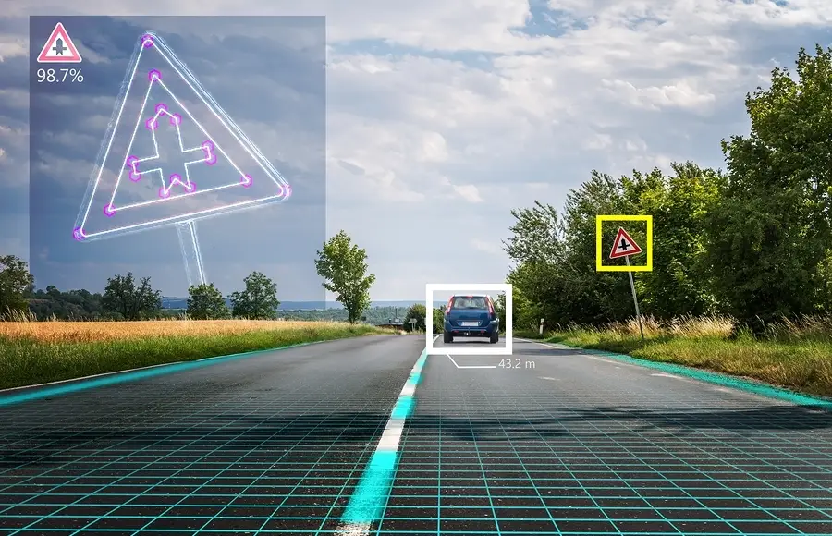
Existing System
Existing System:
Deep learning has gained a tremendous influence on how the world is adapting to Artificial Intelligence since past few years. Some of the popular object detection algorithms are Region-based Convolutional Neural Networks (RCNN), Faster- RCNN, Single Shot Detector (SSD) and You Only Look Once (YOLO).
Disadvantages:
Limited Generalizability
High Computational Requirements

Slide 6
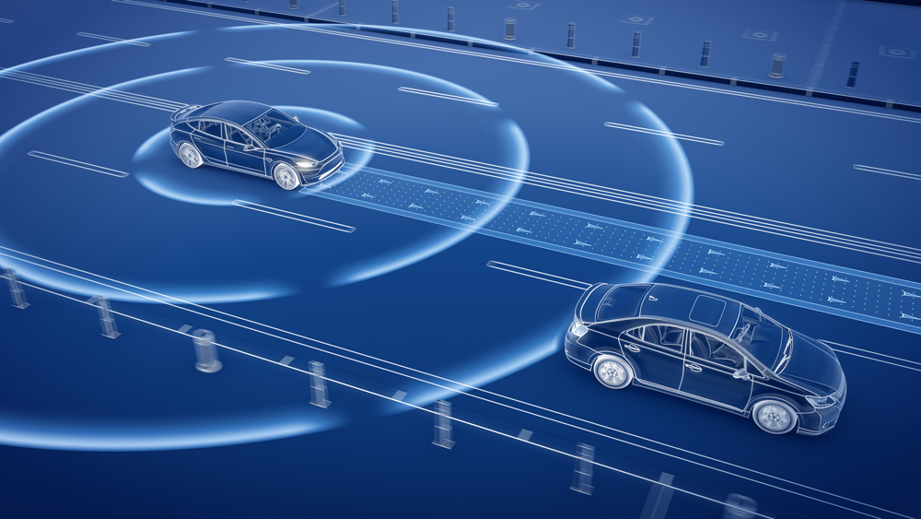
Proposal System
Proposal System :
Real-Time Object Detection using YOLOv4Objective:The objective of this system is to develop a real-time object detection system using the YOLOv4 algorithm, which can accurately detect objects in images and videos.
Advantages:
Enhanced Safety Features
Improved Accuracy and Reliability

Slide 7
System Requirements:
Hardware: A suitable GPU (e.g., NVIDIA GeForce or Tesla) or CPU (e.g., Intel Core i7) for model training and deployment.
Software: A deep learning framework (e.g., TensorFlow, PyTorch), a programming language (e.g., Python), and a suitable operating system (e.g., Ubuntu, Windows).
Dataset: A large, diverse dataset of images and videos annotated with bounding boxes around objects of interest.

Slide 8
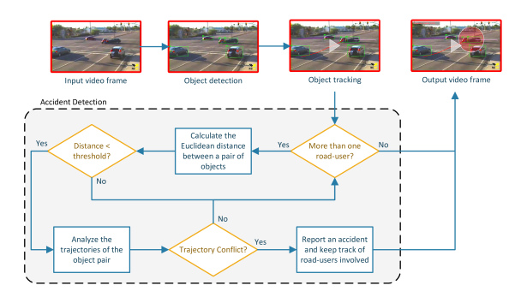
System architecture

Slide 9
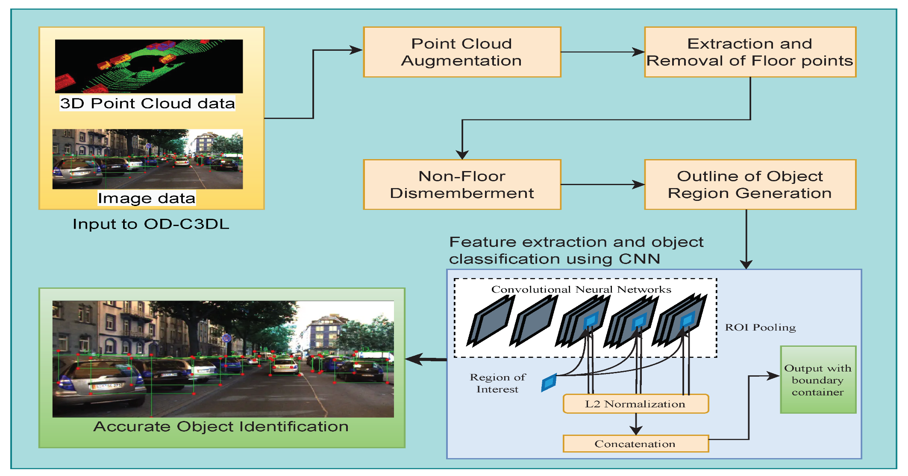
UML Diagram

Slide 10
Modules Overview
1)YOLOv8 (You Only Look Once, version 8)
2)Computer Vision
3)Deep Learning-based Object Detection

Slide 11
Methodology Used
Data Collection & Preprocessing
Collect images and videos from cameras in different environments.
Annotate the data for training object detection and classification models.
Deep Learning-Based Object Detection
Use models like YOLOv8, or SSD (Single Shot MultiBox Detector).
Train the model on datasets like COCO datasets.
Computer Vision for Scene Understanding
Apply edge detection, optical flow, and semantic segmentation.
Detect traffic signs and signals using CNN-based classifiers.

Slide 12
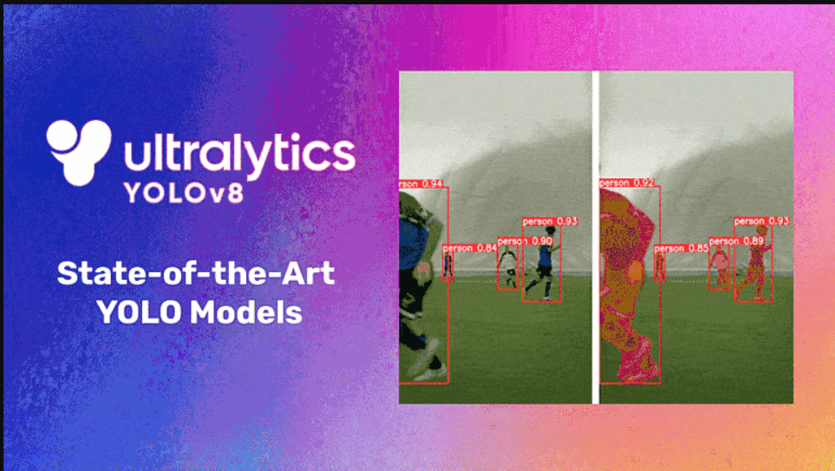
Description of Each Module Module 1
YOLOv8 (You Only Look Once, v8:
YOLOv8 (You Only Look Once, version 8 is a state-of-the-art object detection model that offers improved accuracy, speed, and efficiency, making it ideal for autonomous vehicle navigation. Below is how YOLOv8 can be used in different aspects of the system:

Slide 13
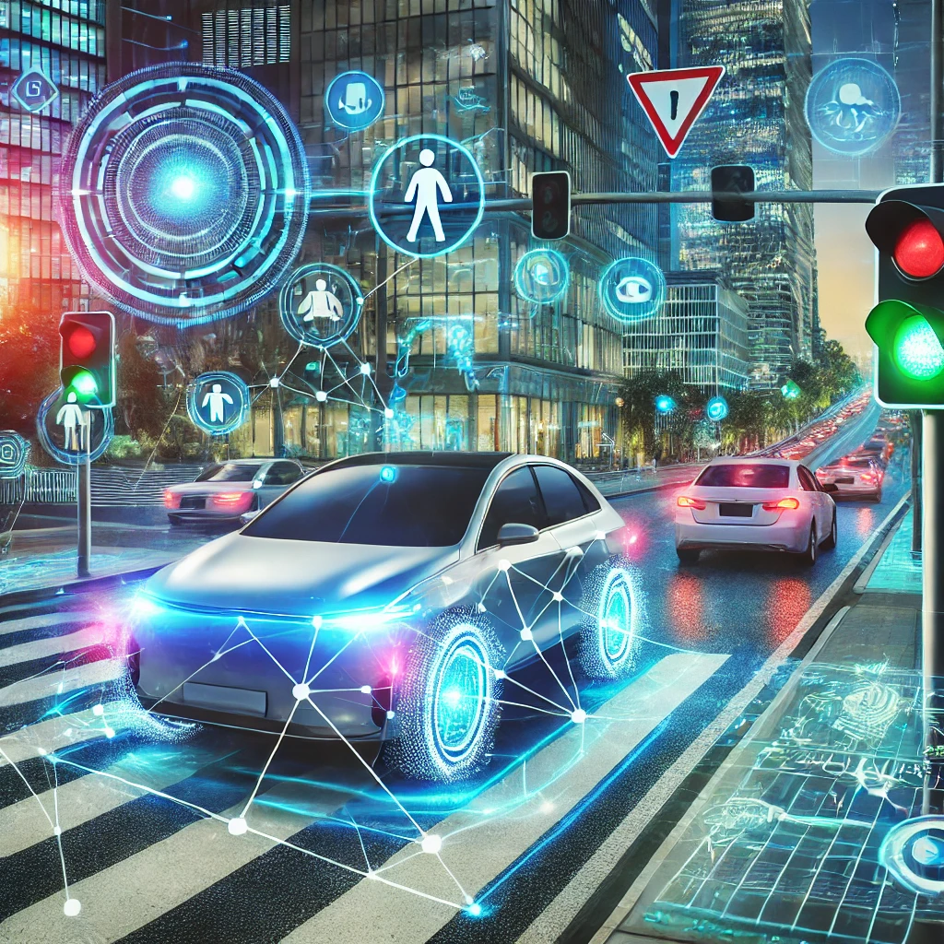
Modules 2
Computer Vision :
Computer Vision is a field of artificial intelligence (AI) that enables computers to interpret and understand visual data from images and videos.
Object Recognition:
Classifying and identifying objects within Images or videos.
Feature Extraction:
Identifying and describing visual features, such as edges, shapes, and textures.

Slide 14
Module 3
Deep Learning-based Object Detection:
Deep learning-based object detection involves identifying and localizing objects within an image or video using deep neural networks.
Feature Extraction
Deep learning models automatically learn features. They extract relevant information from images and sensor data.
Pattern Recognition
Deep learning excels at recognizing complex patterns. It identifies objects, lanes, and traffic signs.

Slide 15
Key Algorithms used in Autonomous Vehicle Navigation System
Algorithm | Technology | Purpose/Function
YOLO (You Only Look Once) | Computer Vision, Deep Learning | Detects and recognizes objects (cars, people, traffic signs) in real-time—fast and accurate.
CNN (Convolutional Neural Network) | Deep Learning | Identifies road lanes, traffic signs, and obstacles from images.
A* (A-Star) | Graph Theory + AI | Finds the shortest and safest path to the destination.
PID Controller | Control Systems | Keeps the vehicle on the right path by adjusting speed and steering.
Deep Neural Network (DNN) | Deep Learning | Learns from sensor data to make driving decisions (e.g., turn, stop, accelerate).
Reinforcement Learning (RL) | Machine Learning | Learns the best driving actions by interacting with the environment.

Slide 16
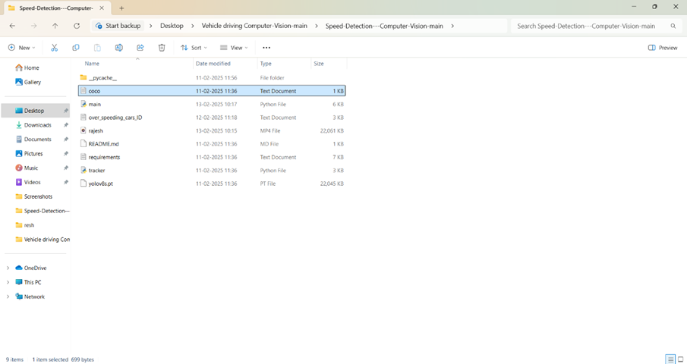
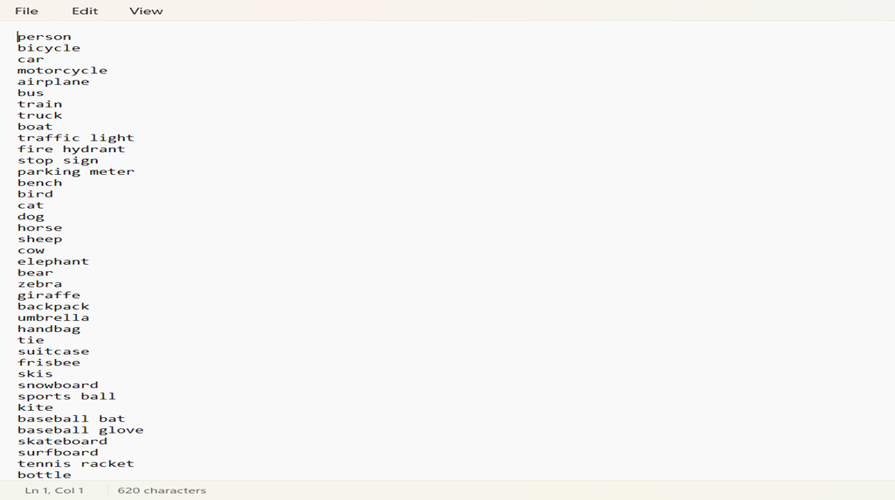
Screen shots

Slide 17
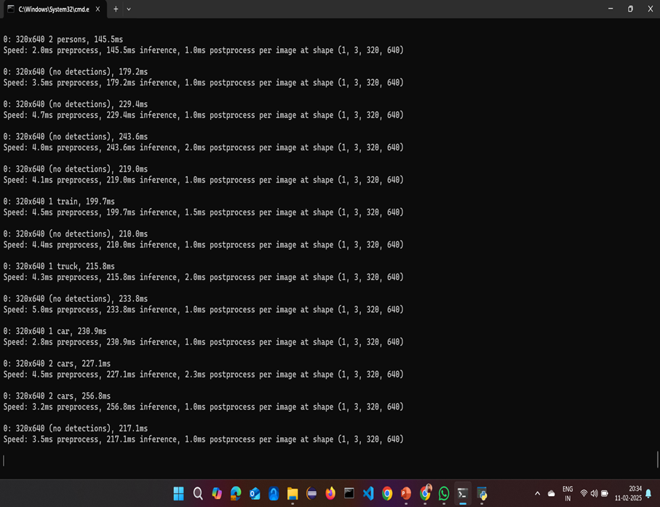
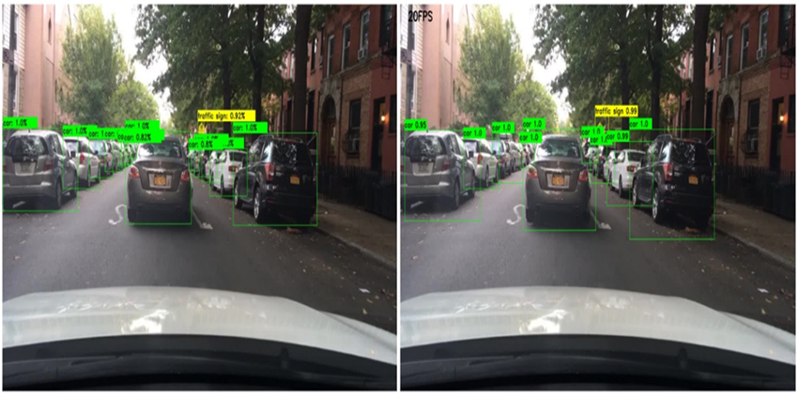

Slide 18
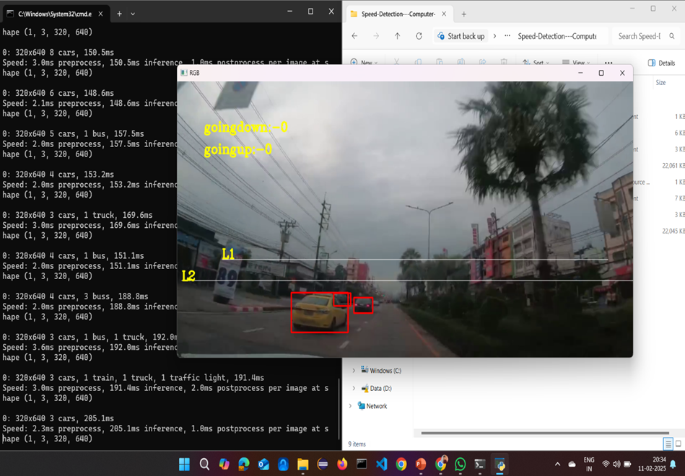
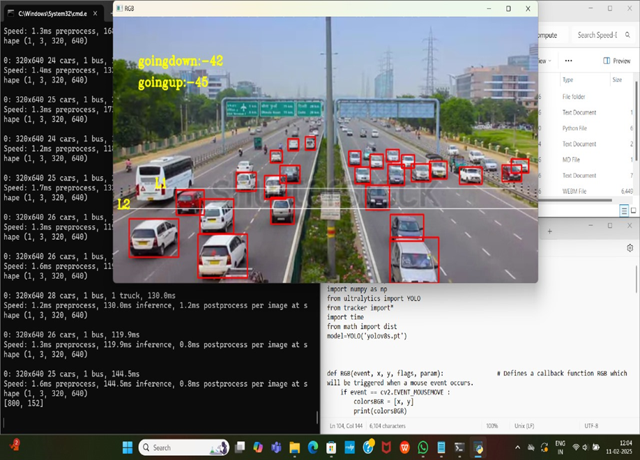
Results

Slide 19
Conclusion and future scope
Conclusion:
Autonomous vehicle navigation using deep learning and computer vision has shown significant advancements in real-time object detection and decision-making. By leveraging recurrent neural networks (RNNs), and other AI models, vehicles can recognize obstacles, traffic signs, pedestrians, and other dynamic elements in their environment. The integration of real-time object detection enhances safety, efficiency, and adaptability, making autonomous driving more reliable. However, challenges such as computational efficiency, sensor fusion, and adverse weather conditions still need further improvements.
Future scope:
1. Improved Deep Learning Models – More efficient AI architectures like Transformer-based models can enhance accuracy and processing speed.
2. Sensor Fusion – Combining LiDAR, radar, and cameras for robust perception in diverse environments.
3. Adverse Weather Adaptability – Enhancing object detection under fog, rain, and low-light conditions.

Slide 20
Thank You

